Slide 1

Predicting the concrete compressive strength based on the concrete's ingredients and age
P NEERAJ , P ANUSHA , ADITYA SRIKANT, MOVVA KALYANA PADMAVATI, SREERAM NITHIN, BHOLE HEMANTH

Slide 2
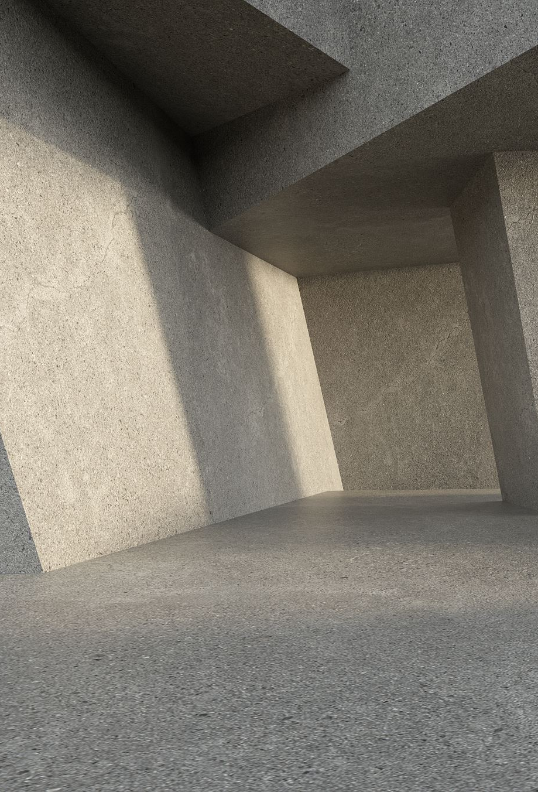
BACKGROUND Objective and path
The Compressive strength of concrete is its ability to resist failure in the form of cracks and the fissure when a specific amount of load is acted upon it. Hence higher the value of Compressive Strength higher the value of concrete to resist failure due to acting load.
Objective : To predict the concrete compressive strength based on the concrete's ingredients and age using linear regression in R.

Slide 3
Information about Dataset
The following information has been taken from UCI repository.
https://archive.ics.uci.edu/ml/datasets/Concrete+Compressive+Strength
The data given in the dataset:
Cement (component 1) -- quantitative -- kg in a m3 mixture -- Input Variable
Blast Furnace Slag (component 2) -- quantitative -- kg in a m3 mixture -- Input Variable
Fly Ash (component 3) -- quantitative -- kg in a m3 mixture -- Input Variable
Water (component 4) -- quantitative -- kg in a m3 mixture -- Input Variable
Superplasticizer (component 5) -- quantitative -- kg in a m3 mixture -- Input Variable
Coarse Aggregate (component 6) -- quantitative -- kg in a m3 mixture -- Input Variable
Fine Aggregate (component 7) -- quantitative -- kg in a m3 mixture -- Input Variable
Age -- quantitative -- Day (1~365) -- Input Variable
Concrete compressive strength -- quantitative -- MPa -- Output Variable

Slide 4
DATA AND DATA QUALITY CHECK
The dataset had 9 attributes and 1030 observations.
All the variables have continuous data. So, we chose Linear Regression
There were 26 rows which had duplicate values, we removed them.

Slide 5
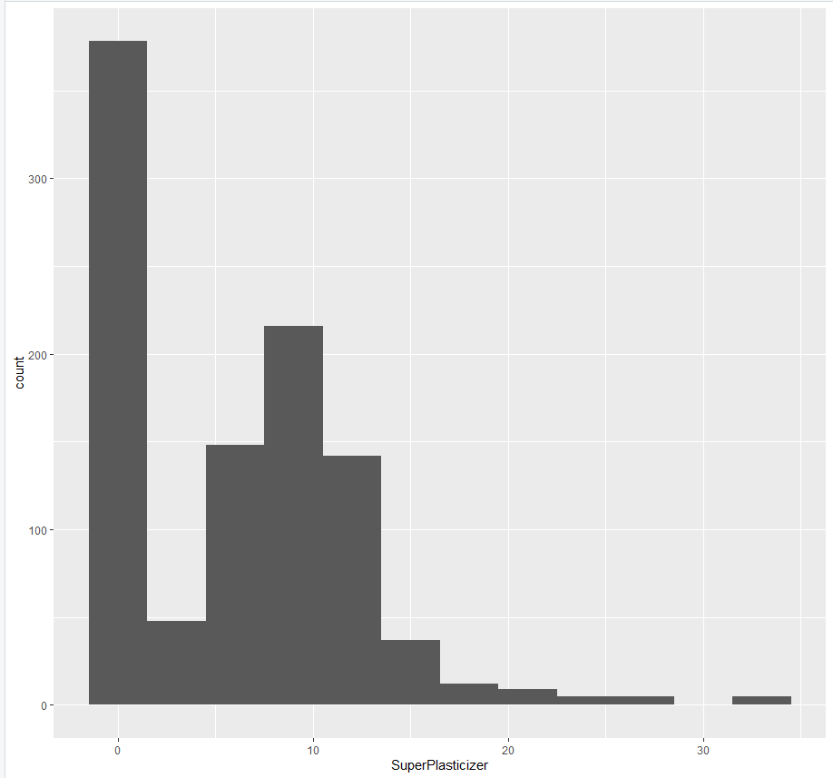
Superplasticizer Histogram

Slide 6
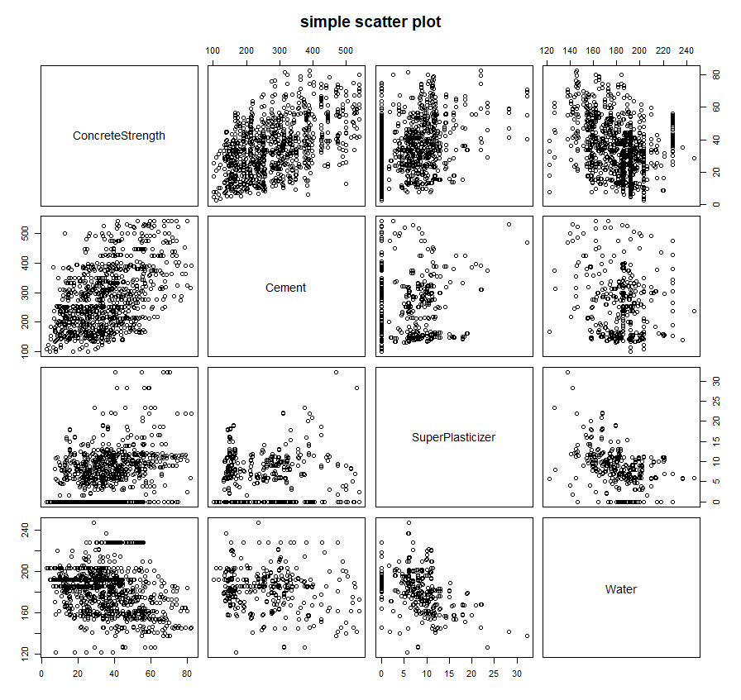

Slide 7
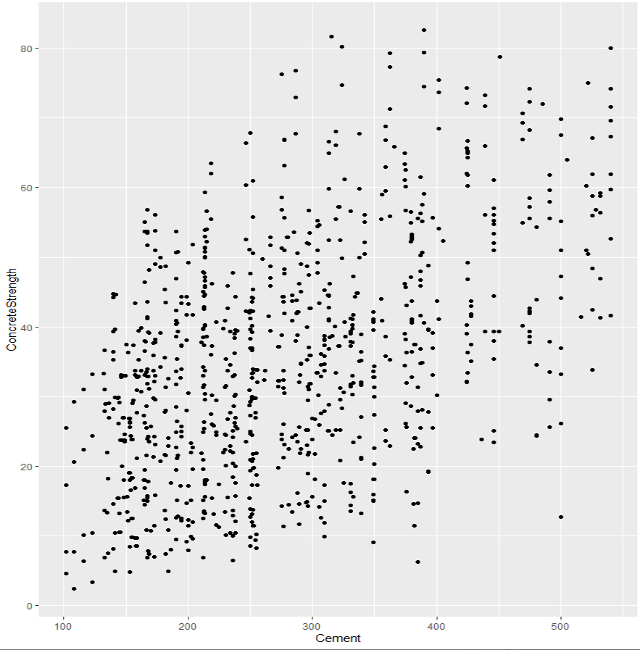
Cement vs concrete strength

Slide 8
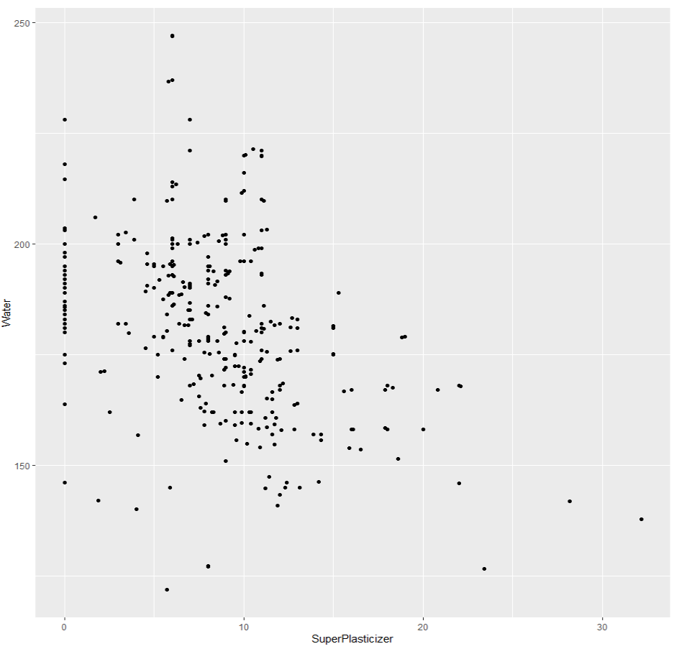
Super plasticizer vs water

Slide 9
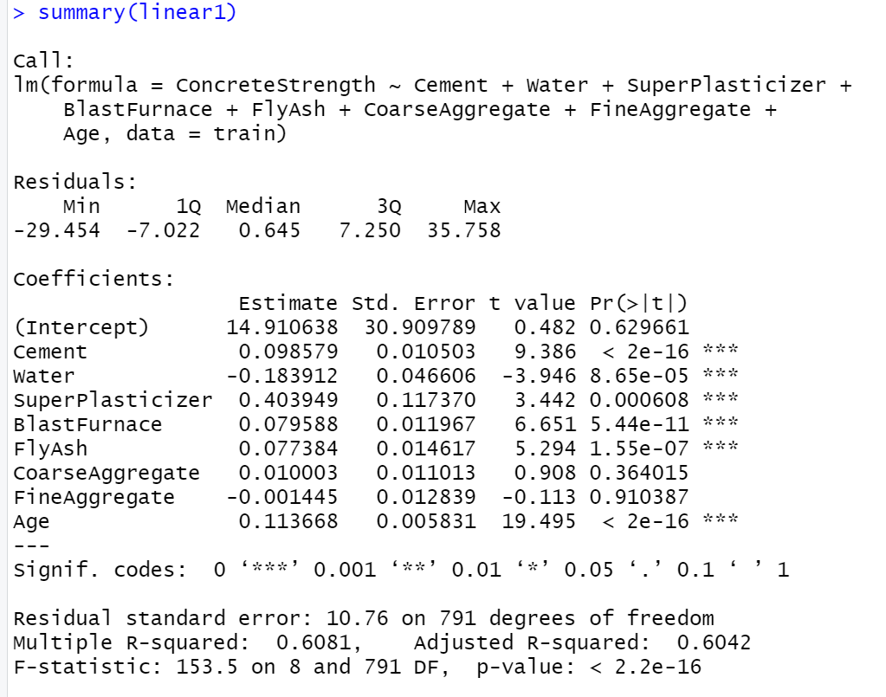
1st Model STATISTICS
The R-squared value of linear2 model is 0.608. This indicates that 60.8% of the variability in the response has been explained by the model.

Slide 10

Mean squared error for 1st model

Slide 11
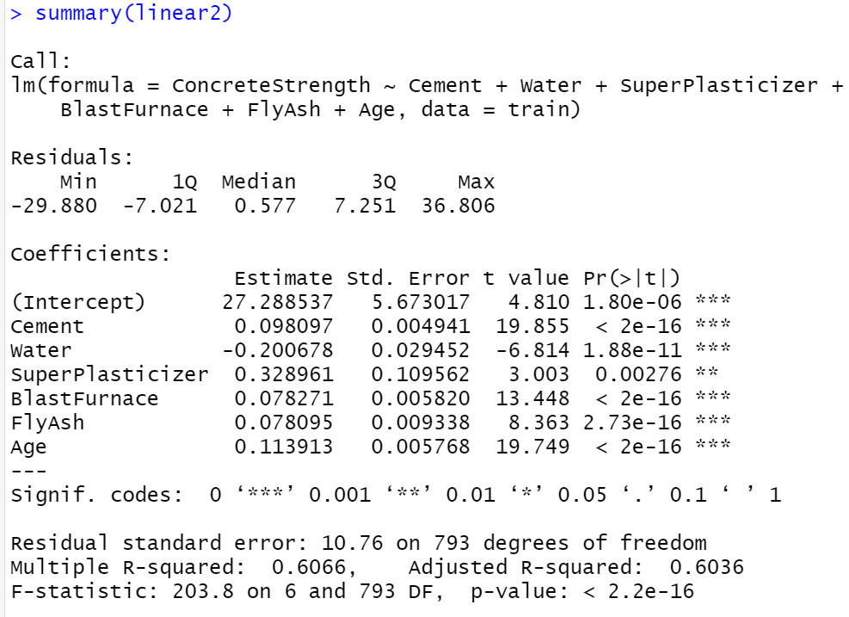
2nd model statistics

Slide 12
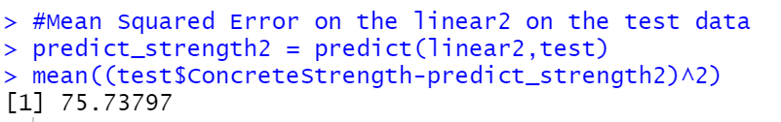
MEAN SQUARED ERROR FOR 2nd MODEL
By removing fine aggregate and coarse aggregate there is a decrease in the mean squared error of the model on the test. We go with second model ( linear2 )

Slide 13
Correlation between response in the test data and the response of linear2 model
There is a correlation of approximately 0.72 between the response in the test data and the output of linear2 model. This is a reasonable amount of correlation. This shows that our model fits the test data up to par.

Slide 14
Appendix

